Slide 1
Composting & its Environmental Benefits
By: Andrea Falar & Leo Sommerheil

Slide 2
What is Composting?
natural process
breaks down & recycles organic matter
ex: uneaten food, vegetable scraps, etc.
speeds natural process by providing environment for decomposers to break down organic food
ex: bacteria, fungi, worms, etc.
results: fertile garden soil (compost)
rich in nutrients & can be used in agriculture, gardening, etc.

Slide 3
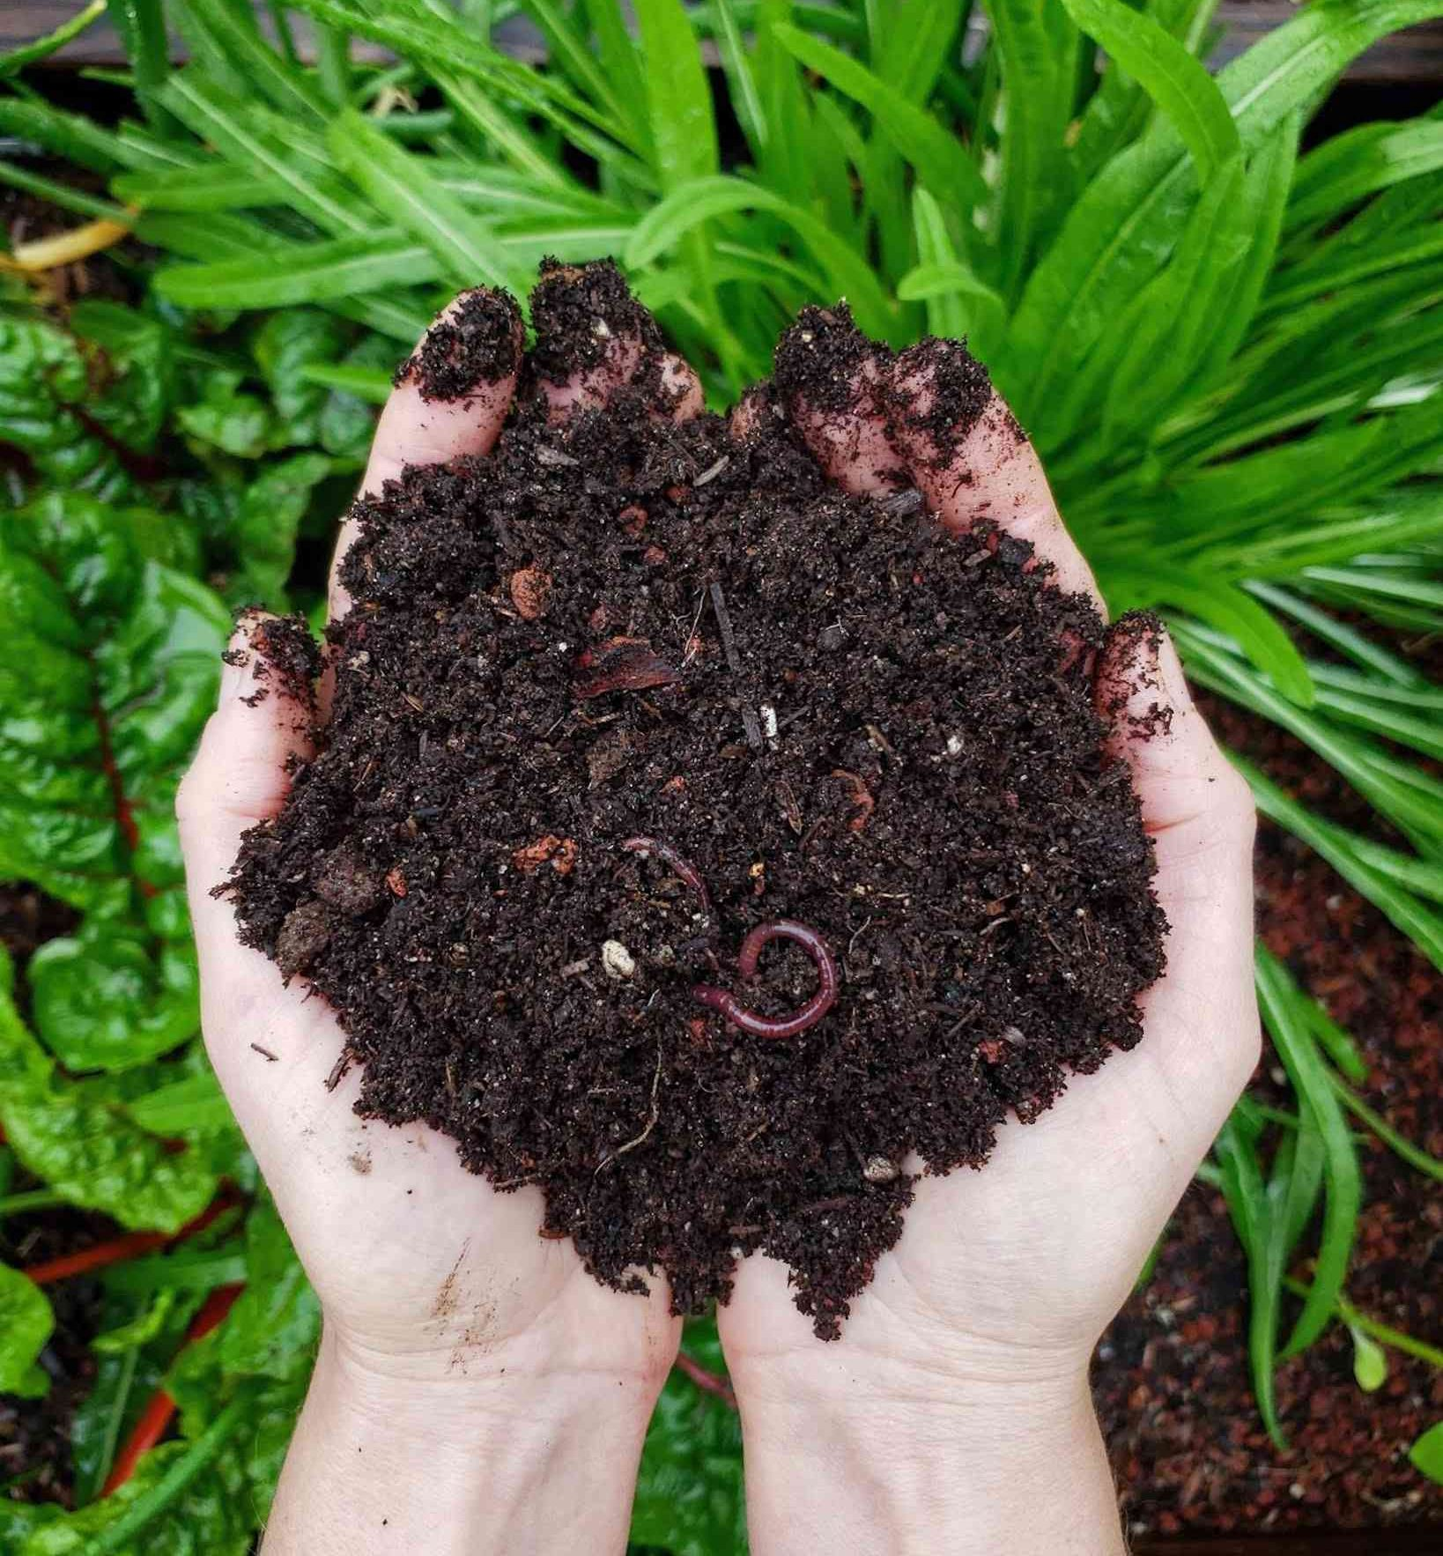
Benefits of Compost
provides nutrients & moisture to soil
reduces need for chemical fertilizers
environmentally positive
reduces waste
reduces methane emissions (in landfills)

Slide 4
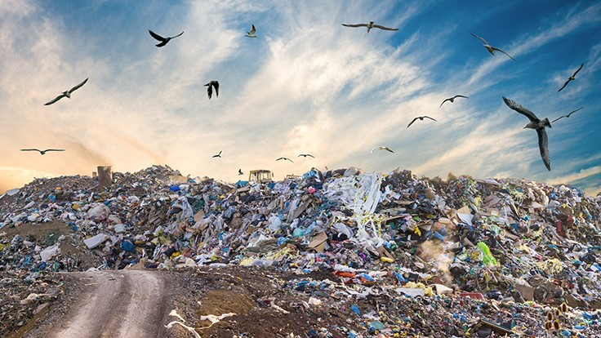
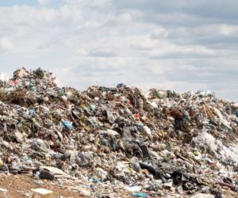
Why is this Important?
landfills are growing
billions of pounds of waste in the US alone
most waste can easily be recycled or turned into compost
causes accumulation of methane (greenhouse gas)
methane contributes to climate change & global warming
Notes:
This experiment is more than just a plan to waste your time. Every year, billions of pounds of unused materials and waste are thrown into landfills in the United States. A lot of the waste thrown into these landfills could easily be recycled or turned into compost! However, when organic waste accumulates in these landfills, through anaerobic processes, methane is created. Methane is the warmest greenhouse gas that contributes to climate change and global warming.

Slide 5
Who does this Issue Affect?
worldwide issue
more serious in developing countries
less regulations on waste disposal
methane emissions contribute to climate change
warming of the planet
affect ecosystems, agriculture, businesses, & livelihoods
threat to animals
change in habitat/climate → forced removal

Slide 6
How to Sort your Waste Properly
Landfill Bin
Compost Bin
Recycling Bin
inorganic materials
plastic no. 6 - polypropylene
styrofoam
other materials that don’t belong in the compost or recycling bin
organic materials
uneaten food
vegetable/plant scaps
bones/meat
dead leaves & other plant material
plastics
EXCEPT: plastic no. 6 (polypropylene - cannot be mixed with other plastics)
aluminum/metals
ex: tin cans
cardboard

Slide 7
What did We Learn?
What composting is
composting reduces waste & methane emissions in landfills
There are three separate bins to place your waste
Be conscious of where you put your waste!
Notes:
composting is the enhancement of the natural process that breaks down organic materials

Slide 8
Thank You For Listening!
If you have any questions email: thegreencauseinitiative@gmail.com

Slide 9
Works Cited
“Composting At Home.” EPA, Environmental Protection Agency, 10 Feb. 2021, www.epa.gov/recycle/composting-home#benefits.
July 20, 2020 Shelia Hu. “Composting 101.” NRDC, 20 July 2020, www.nrdc.org/stories/composting-101#whatis.

