Slide 1
Palm oil
By Shalini Ramakrishnan
Notes:
https://zoom.us/j/96524058316?pwd=RVZEMERQV1d6eU8wNm9GcEtESllVdz09

Slide 2
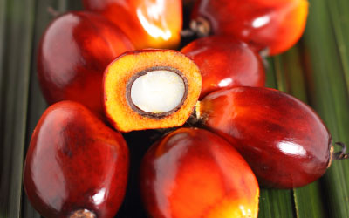
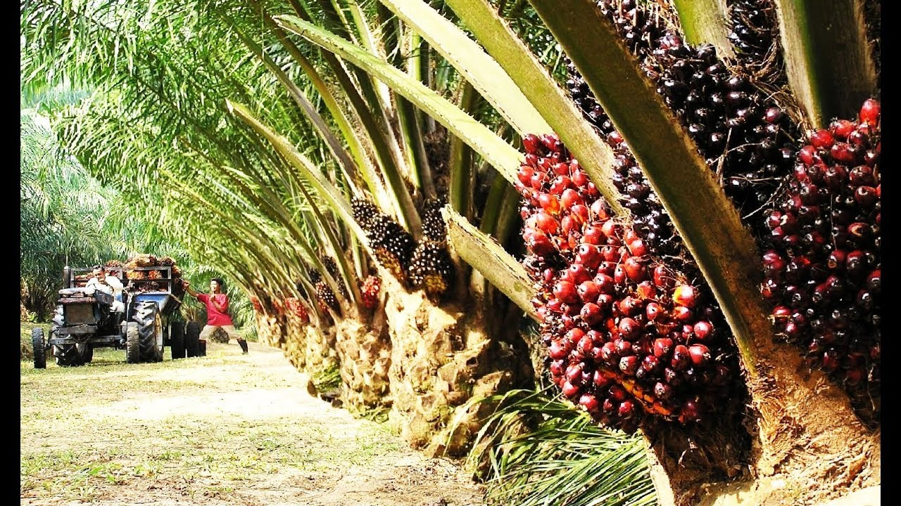
What is Palm Oil?
Edible vegetable oil that comes from Palm trees
The oil produced can be crude palm oil or palm kernel oil.
Native to West Africa
  Now commonly grown in Southeast Asia
Most common produced vegetable oil
81.6 million tons produced
Found EVERYWHERE

Slide 3
Pop Quiz!!!!
How many tons of palm oil was produced between 2018-2019?
81.4
81.6
81.8
82.0
CORRECT ANSWER: B 81.6 million tons

Slide 4
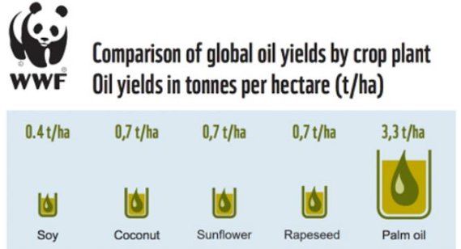
Why is Palm Oil Important?
Used everywhere
  Pizza, deodorant, donuts
  Found in 50% of packaged items (IUCN)
Very efficient oil crop
Commodity
  People in developing countries rely on this
Versatile
  Long shelf life
  High heat resistance
Cheap
  Low shelf price

Slide 5
Before we continue…...
Take a minute and find something in your house that has palm oil in it…
What is it?
Try to search some alternatives of that product that doesn’t have palm oil.

Slide 6
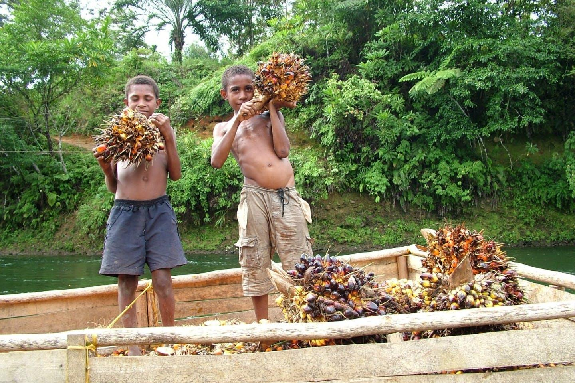
Issues surrounding Palm Oil
Deforestation
  Destroyed habitat for orangutan species, pygmy elephant, and Sumatran rhino
  Caused 56% of the deforestation of the island of Borneo
Millions of tons of carbon dioxide is emitted
  The carbon rich soil being exposed
Child labour and Exploitation
  Children doing physical work on plantations
    Dropping out of school
  Toxic chemicals are used on site
  Long hours with physically challenging tasks
  Penalties
    Picking up too little or unripe fruit

Slide 7

STOP!
Why is deforestation bad?

Slide 8
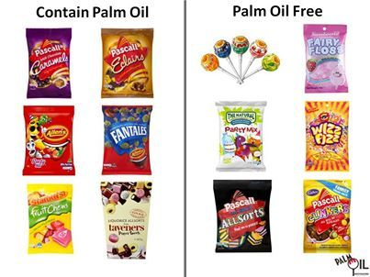
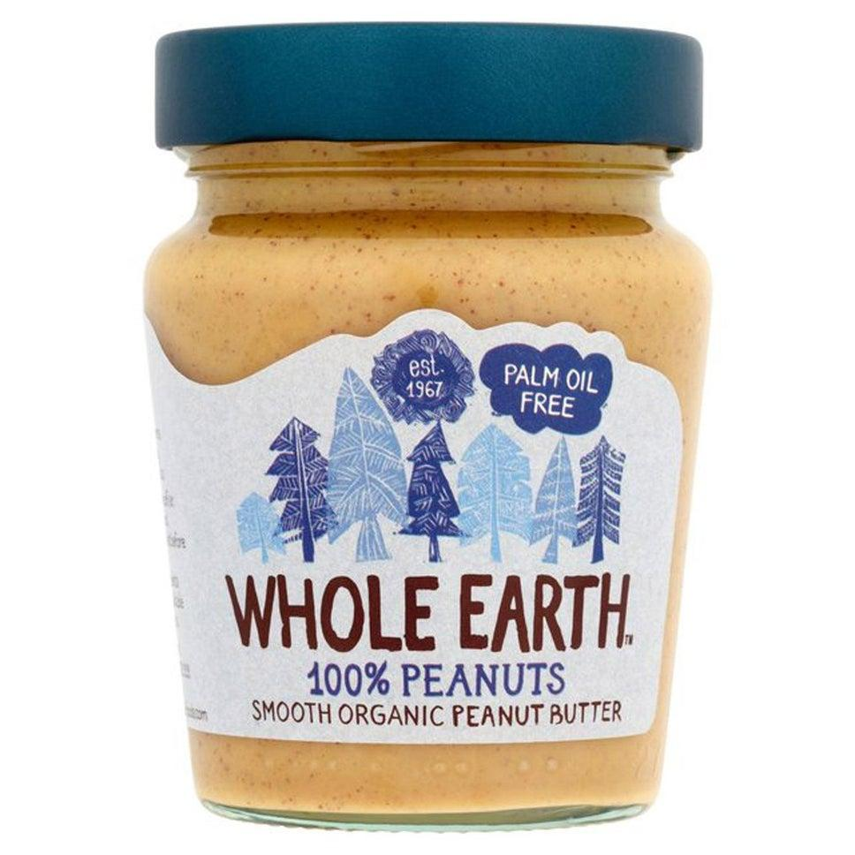
Solutions
AWARENESS
Limit use of palm oil products
Another option is to opt for alternative resources.
  shea oils, jojoba oils, and sal oils

Slide 9
Alternatives
Products with Palm Oil | Products without Palm Oil
Skippy (Peanut Butter) | Whole Earth, Meridian (Peanut Butter)
Wall’s Soft Scoop | Ben & Jerry’s
Cadbury’s Dairy Milk Chocolate | Divine
Ritz Crackers | Hippeas, Yoyo
Oreos | All shortbread, M&S all butter cookies
Head & Shoulders (shampoo) | Matrix Biolace Shampoo
Dove Original (soap) | Lush soaps

Slide 10
Conclusion
Although Palm oil has many uses, it has devastating effects on the environment and those who work in the palm oil industry. You can change this by limiting your use of palm oil as much as possible and bringing awareness to the harmful effects of palm oil. Checking out websites like https://productswithoutpalmoil.com/palm-oil-free-products-list/ and more can help you find more altneratives. Your actions can create a domino effect to help the environment.

Slide 11
Thank you!
Feel free to reach out with any questions!!
Email thegreencauseinitiative@gmail.com

Slide 12
Sources
https://www.livescience.com/palm-oil.html
https://www.wwf.org.uk/updates/8-things-know-about-palm-oil
https://www.bbc.co.uk/newsround/39492207
https://www.amnesty.org/en/latest/news/2016/11/palm-oil-global-brands-profiting-from-child-and-forced-labour/

