Slide 1
Pollution
By: Jasmine Ali

Slide 2
AIR POLLUTION
Air pollution is caused by solid and liquid particles and certain gases that are suspended in the air. The solid and liquid particles suspended in our air are called aerosols

Slide 3
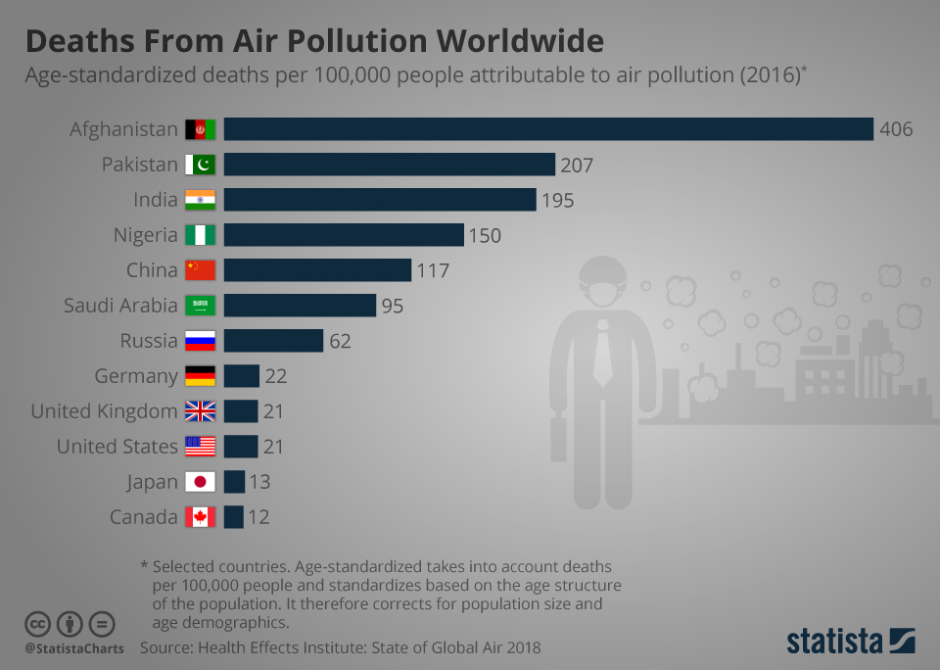
More about Aerosols
Notes:
Any particle that gets picked up into the air or is formed from chemical reactions in the air can be an aerosol. Many aerosols enter the atmosphere when we burn fossil fuels—such as coal and petroleum—and wood. These particles can come from many sources, including car exhaust, factories and even wildfires. Some of the particles and gases come directly from these sources, but others form through chemical reactions in the air. Aerosols can come from other places, too, such as ash from an erupting volcano. Dust, pollen from plants and mold spores are also examples of aerosols. While most aerosols remain in the atmosphere from between four days and a week, they also have the potential to travel great distances in that time, moving thousands of miles in a week. Aerosols’ ability to change the reflectivity of the planet is known as the albedo of the planet. While light colores aerosols can cool our planet, black carbon or brown carbon/organic matter, will absorb light radiation, adding to warming the atmosphere. Reflective aerosols tend to brighten clouds and make them last longer, while black carbon can stop cloud formation or warm the surrounding atmosphere and cause droplets to evaporate, turning clouds into a haze that suppresses precipitation. Aerosols are one of the main air pollutants, leading to the premature deaths of millions of people every year as they damage lungs and can even enter the bloodstream. 8.8 million people a year die from air pollution.

Slide 4
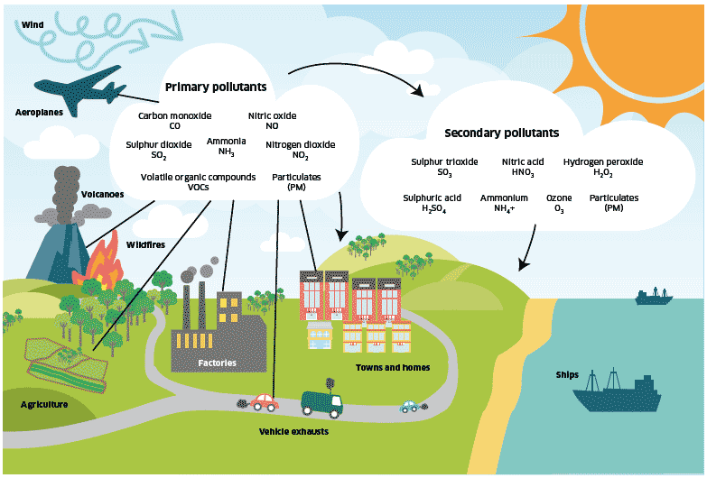

Slide 5
What is Ozone?

Slide 6
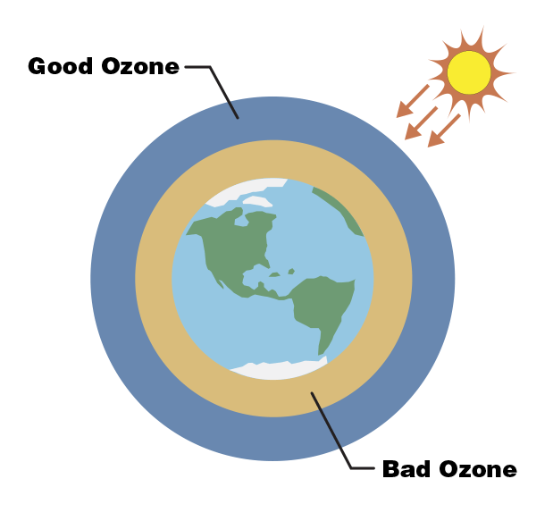
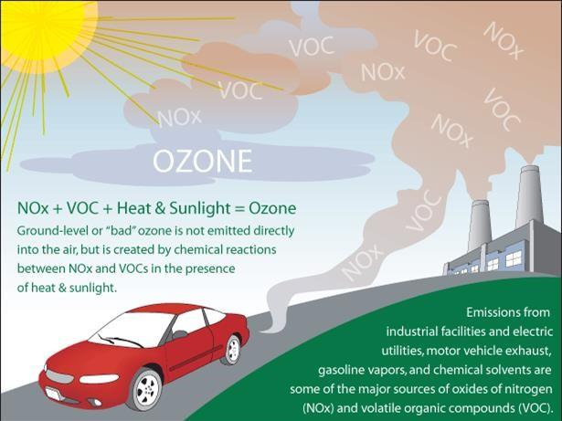
Notes:
Any particle that gets picked up into the air or is formed from chemical reactions in the air can be an aerosol. Many aerosols enter the atmosphere when we burn fossil fuels—such as coal and petroleum—and wood. These particles can come from many sources, including car exhaust, factories and even wildfires. Some of the particles and gases come directly from these sources, but others form through chemical reactions in the air. Aerosols can come from other places, too, such as ash from an erupting volcano. Dust, pollen from plants and mold spores are also examples of aerosols. While most aerosols remain in the atmosphere from between four days and a week, they also have the potential to travel great distances in that time, moving thousands of miles in a week. Aerosols’ ability to change the reflectivity of the planet is known as the albedo of the planet. While light colores aerosols can cool our planet, black carbon or brown carbon/organic matter, will absorb light radiation, adding to warming the atmosphere. Reflective aerosols tend to brighten clouds and make them last longer, while black carbon can stop cloud formation or warm the surrounding atmosphere and cause droplets to evaporate, turning clouds into a haze that suppresses precipitation. Aerosols are one of the main air pollutants, leading to the premature deaths of millions of people every year as they damage lungs and can even enter the bloodstream. 8.8 million people a year die from air pollution.

Slide 7
WATER
POLLUTION

Slide 8
Water Pollution
Waste, chemicals, or other particles cause a body of water to become harmful to the fish and animals that need the water to survive.
Notes:
Water pollution can disrupt and negatively impact nature's water cycle as well. A lot of water pollution comes from human activity. Some human causes include sewage, pesticides and fertilizers from farms, waste water and chemicals from factories, silt from construction sites, and trash from people littering. Air pollution can also have a direct effect on water pollution. When particles like sulfur dioxide get high into the air they can combine with rain to produce acid rain. Acid rain can turn lakes acidic, killing fishes and other animals. Sometimes pollution affects the entire food chain. Small fishes absorb pollutants, such as chemicals, into their bodies. Then bigger fishes eat the smaller fishes and get the pollutants too. Plastic pollution is also a major threat. While it’s tough to say exactly how much plastic is in the ocean, scientists think about 8 million metric tons of plastic enter the ocean every year.

Slide 9
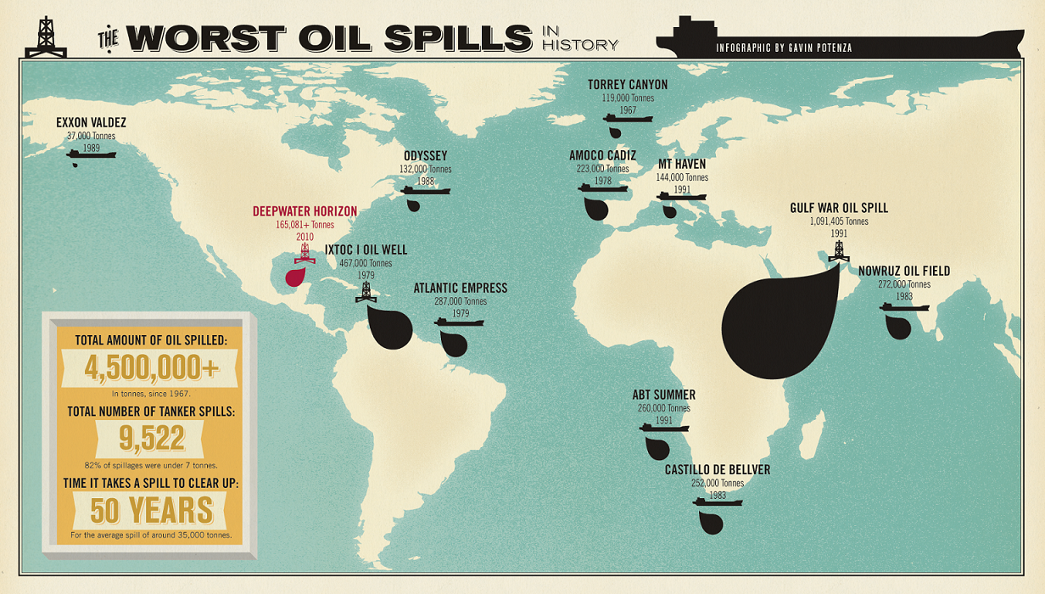
Oil Spills
Notes:
Oil destroys the insulating ability of fur-bearing mammals, such as sea otters, and the water repellency of a bird's feathers, thus exposing these creatures to the harsh elements. Without the ability to repel water and insulate from the cold water, birds and mammals will die from hypothermia. Juvenile sea turtles can also become trapped in oil and mistake it for food. Dolphins and whales can inhale oil, which can affect lungs, immune function and reproduction. Many birds and animals also ingest oil when they try to clean themselves, which can poison them. Fish, shellfish, and corals may not be exposed immediately, but can come into contact with oil if it is mixed into the water column — shellfish can also be exposed in the intertidal zone. When exposed to oil, adult fish may experience reduced growth, enlarged livers, changes in heart and respiration rates, fin erosion, and reproduction impairment. Fish eggs and larvae can be especially sensitive to lethal and sublethal impacts. Even when lethal impacts are not observed, oil can make fish and shellfish unsafe for humans to eat. When an oil slick from a large spill reaches a beach, oil coats and clings to every rock and grain of sand. If the oil washes into coastal marshes, mangrove forests, or other wetlands, fibrous plants and grasses absorb oil, which can damage plants and make the area unsuitable as wildlife habitat.

Slide 10
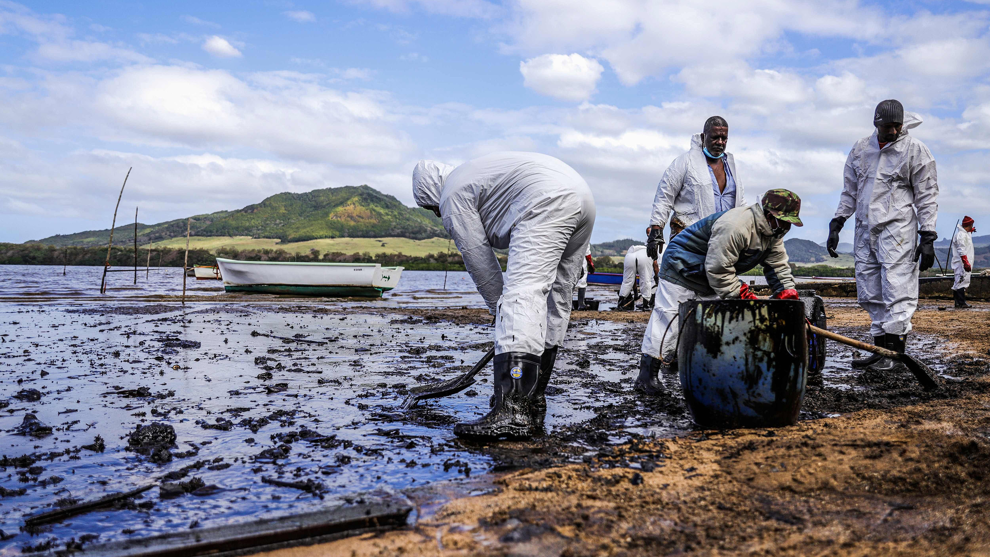
Mauritius

Slide 11
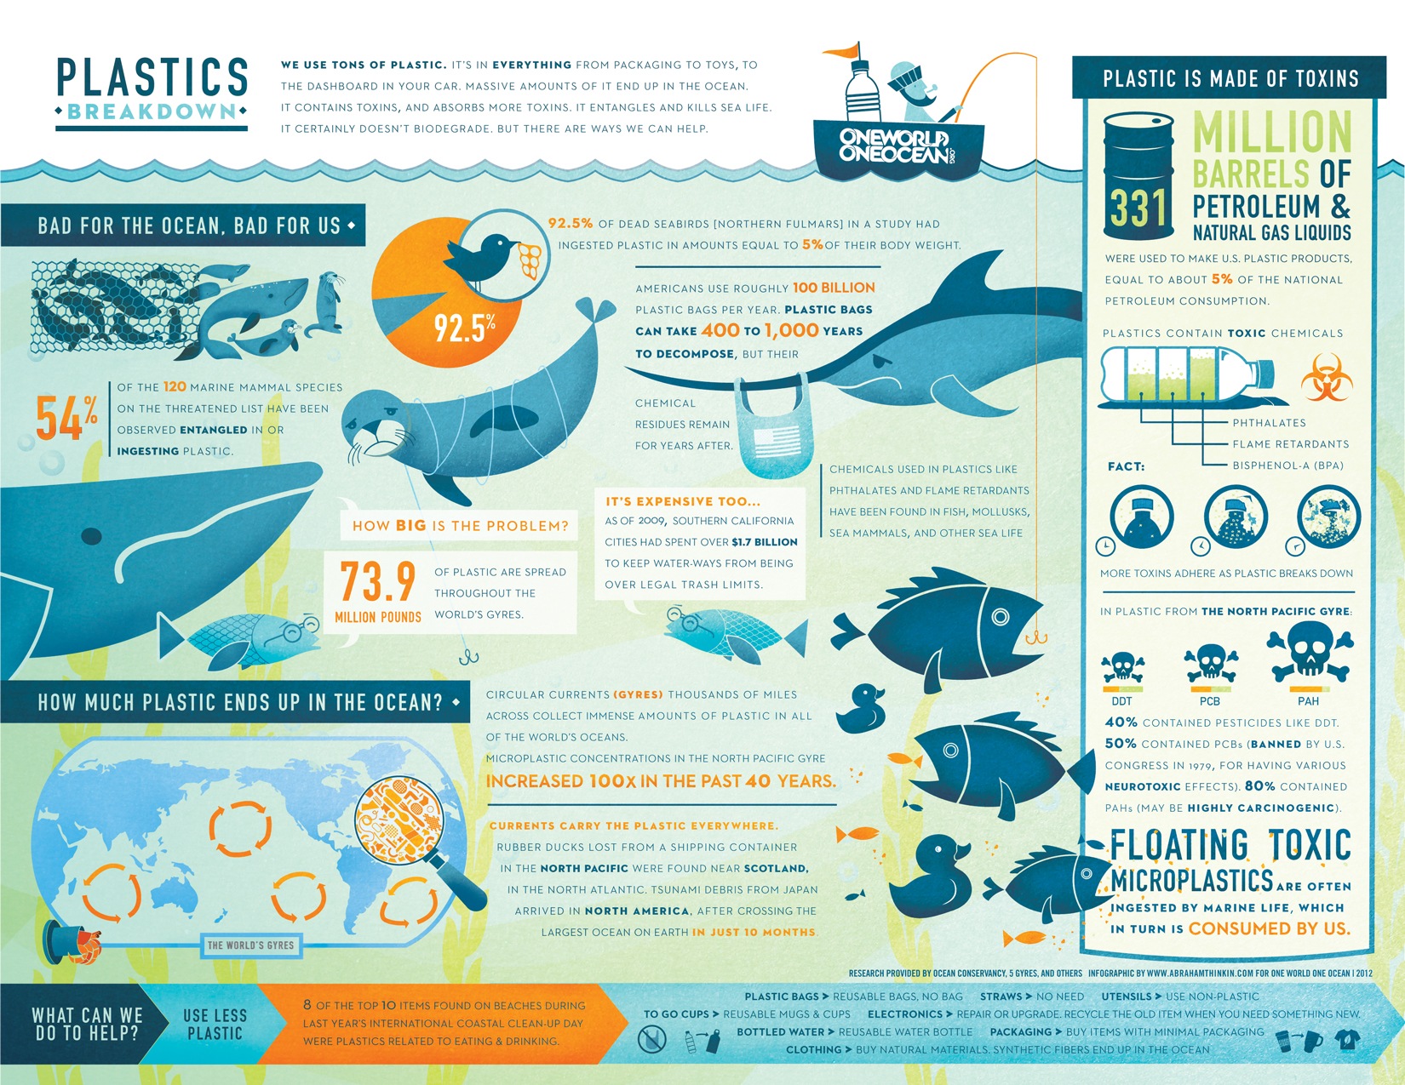

Slide 12
Stories Of Hope
We Must Take Action NOW
“We can't save the world by playing by the rules, because the rules have to be changed. Everything needs to change - and it has to start today.”

Slide 13
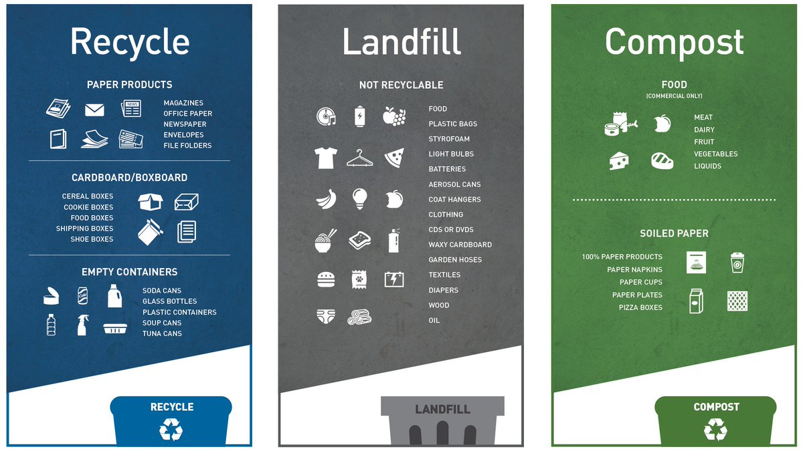
What YOU can do!

Slide 14
Brainstorm:
What are some ways YOU can reduce your own waste?

Slide 15
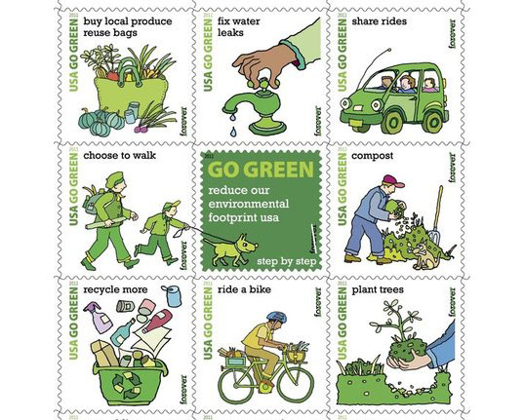
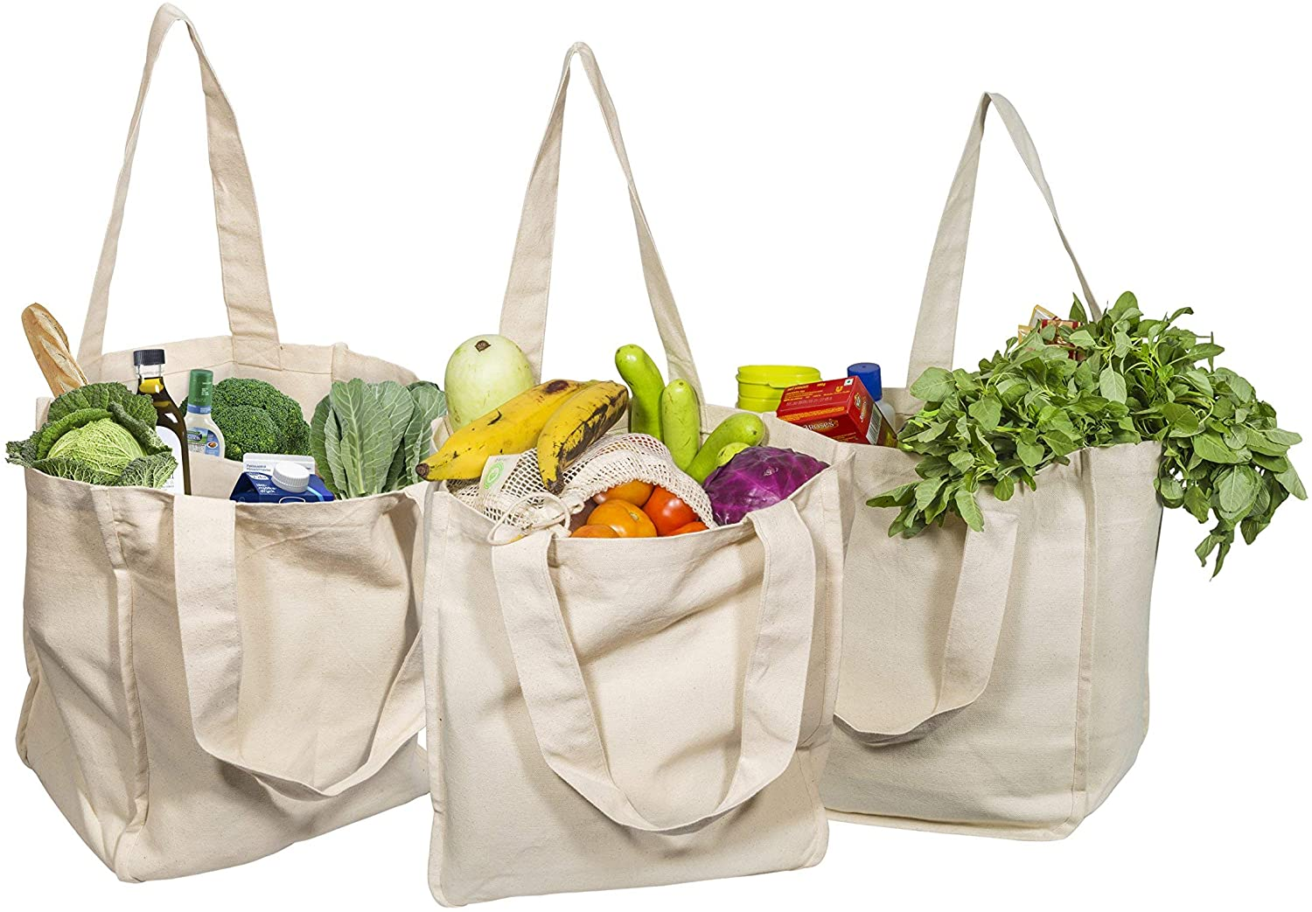
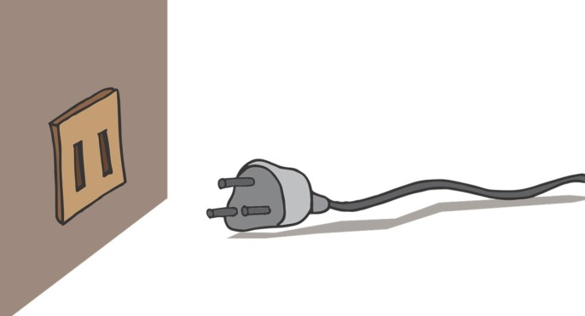
Examples:

Slide 16
REVIEW
What Have You Learned?

Slide 17
THANK YOU!
If you have any questions email thegreencauseinitiative@gmail.com

