Slide 1
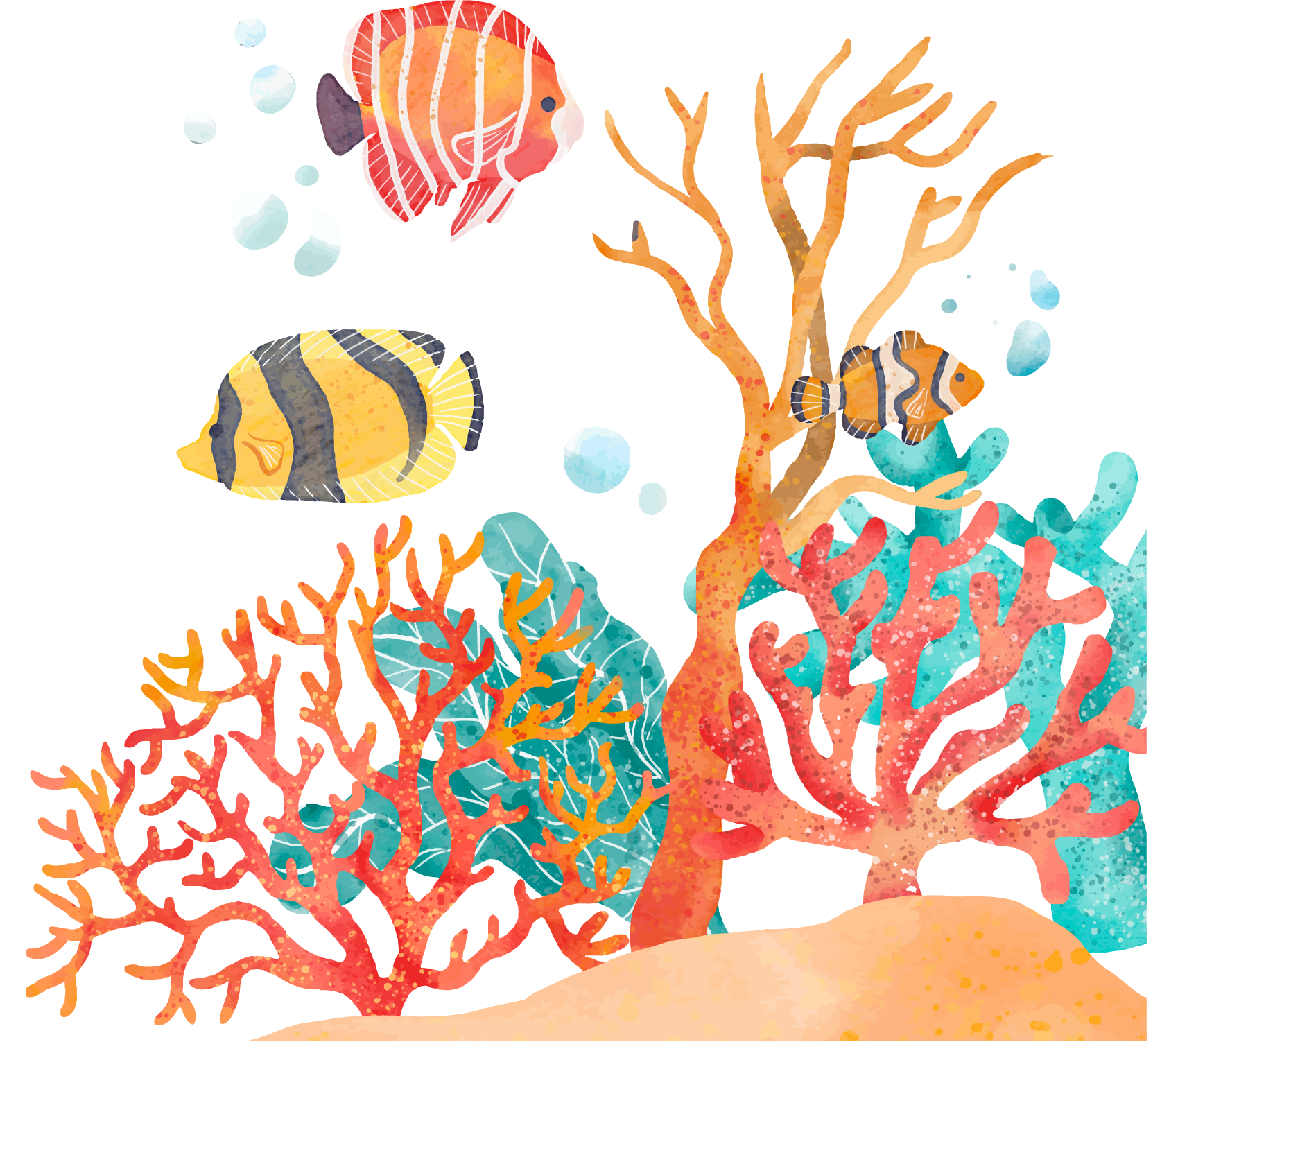
OCEANS
By: Jasmine Ali

Slide 2
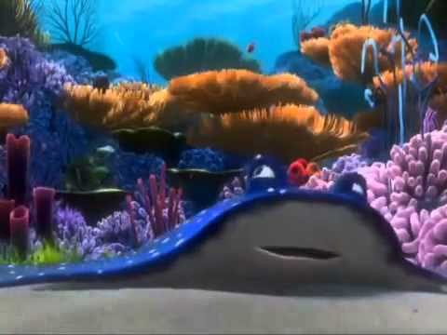
Finding Nemo Coral Reef

Slide 3
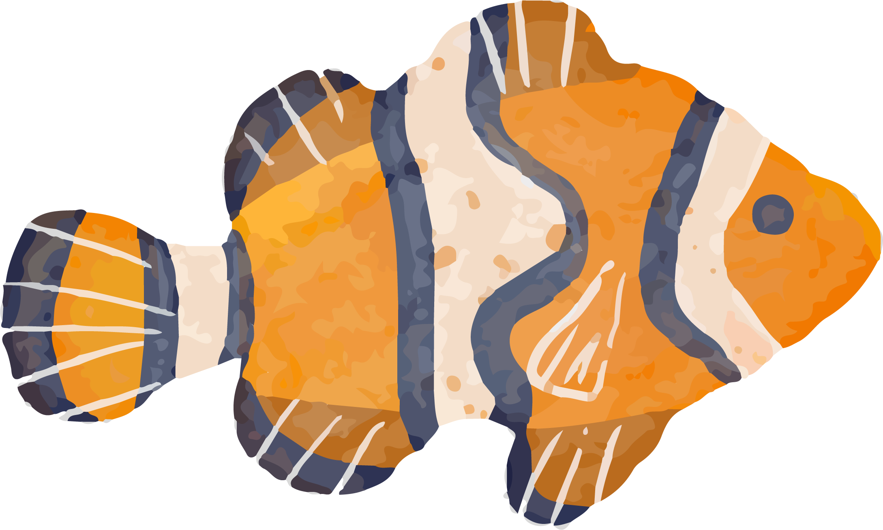
WHY ARE OUR OCEANS IMPORTANT?
Notes:
The Ocean is the heart of the planet. Water covers more than two-thirds of the Earth’s surface. The deep waters are home to wildlife and some of the biggest creatures on earth. It provides us with food, jobs, life, entertainment, and sailing. Without it, we cannot survive. Why should we care so much about the creatures that live in the ocean? Does it matter if a species disappear? What does that mean for us?

Slide 4
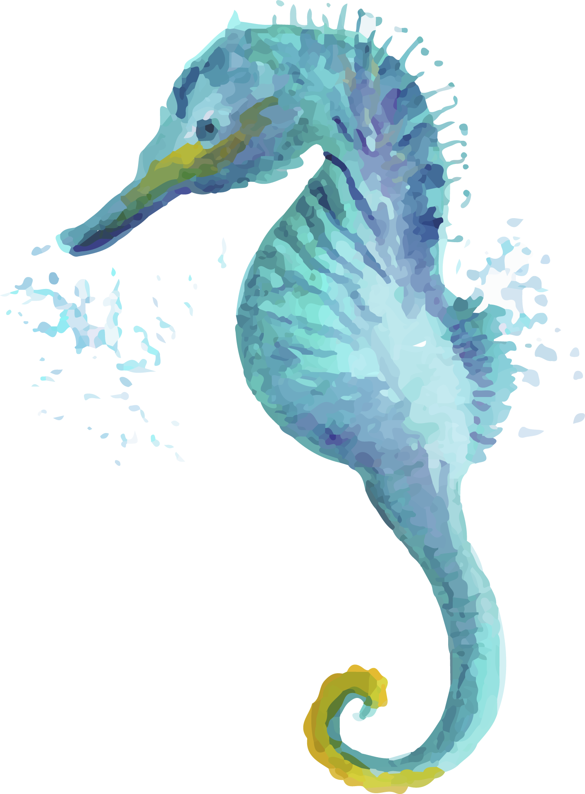
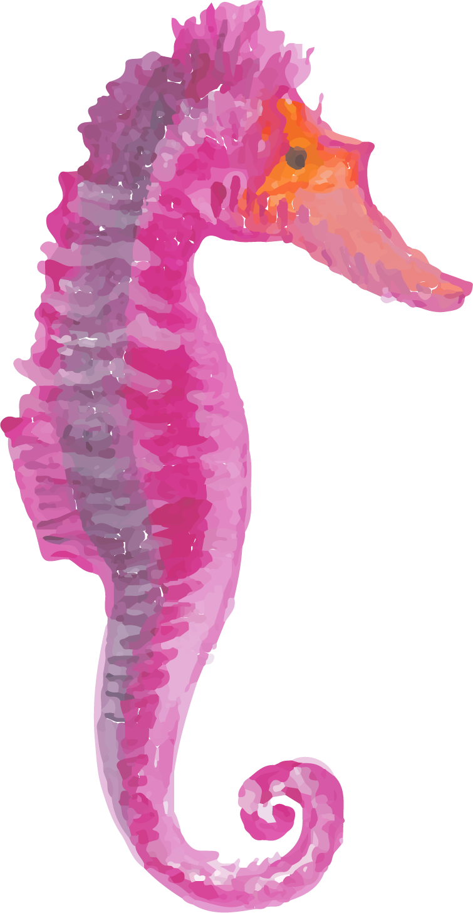
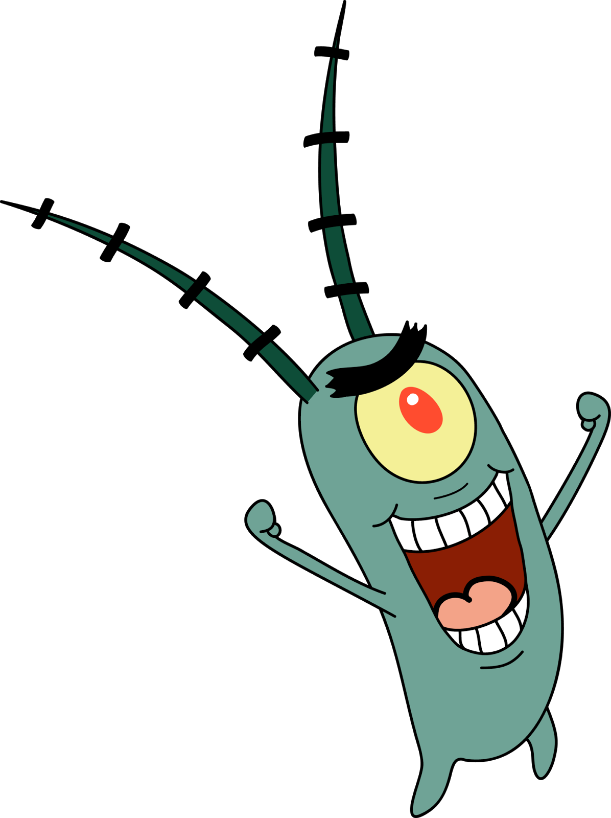
OXYGEN
What does oxygen have to do with the ocean?
What creatures breathe out oxygen?
Notes:
Oceans are responsible for 70% of the oxygen we breathe- that’s more than the trees in the Amazon!
Phytoplankton, a microscopic plant that lives in the ocean, act the same. They carry out photosynthesis. They are one of the tiniest beings on the planet, but they keep us alive.

Slide 5
CLIMATE
How does the ocean regulate our climate?
Transporting and taking in heat
Controls rains and droughts
Absorb C02
Important to the water cycle
Notes:
In many ways, the sea regulates our climate. It soaks up the heat and transports warm water from the equator to the poles, and cold water from the poles to the tropics. Without these currents, the weather would be extreme in some regions, and fewer places would be habitable. It regulates rain and droughts. Holding 97% of the water of our planet, almost all rain that drops on land comes from the sea. The ocean absorbs CO2, to keep the carbon cycle and temperatures on earth, in balance.
To explain absorbing CO2-
Fish and other animals in the ocean breathe oxygen and give off carbon dioxide, just like land animals. Ocean plants take in the carbon dioxide and give off oxygen, just like land plants. The ocean is great at sucking up CO2 from the air. It absorbs about one-quarter of the CO2 that we humans create when we burn fossil fuels. If not for the ocean, we'd be in even worse trouble with too much CO2. However, the ocean and everything in it are paying a price. The ocean is becoming more acidic.

Slide 6
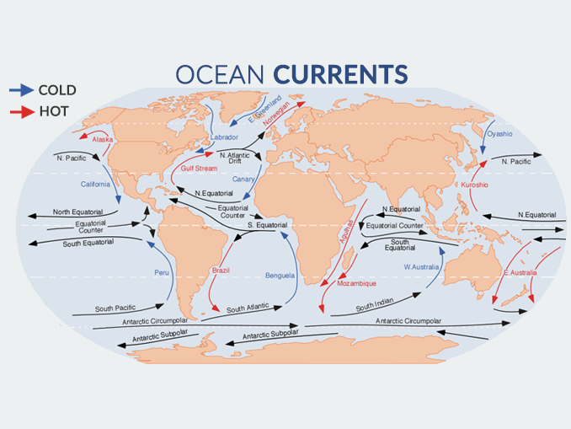

Slide 7
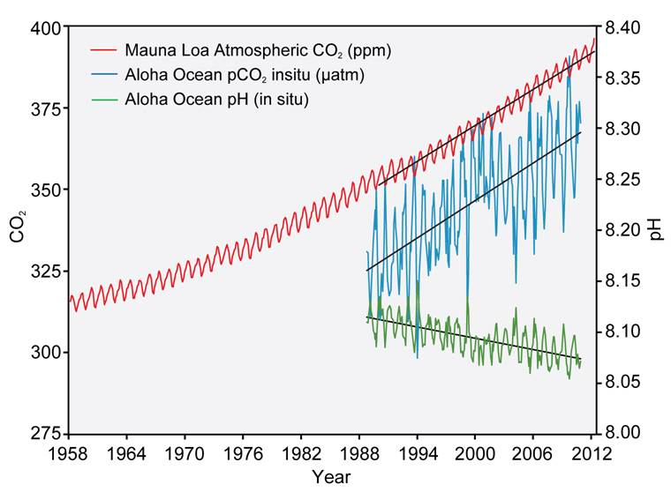

Slide 8
FOOD AND JOB
What kinds of jobs involve the ocean?
Notes:
The ocean is the number one source of protein for more than a billion people. Although, not everything is fish and seafood. There is also a heavy reliance on the ocean for employment. 59.6 million people in the world were engaged in fisheries and aquaculture in 2016. 90% of the world trade is made by sea. In the U.S. close to three million jobs are directly dependent on the resources of the oceans and Great Lakes.

Slide 9
MARINE LIFE
There are more than 300,000 different species underwater.
Example: Coral reefs
Notes:
The ocean is not just home to us ocean lovers, but it is home to the greatest abundance of life on our planet. Experts predict that there are more than 300,000 different species underwater, and it is still not clear how many of them we know. Coral reefs provide a habitat for marine species as well as protect land from coastal erosion. All the creatures that live in the Ocean play an essential role in the trophic chain of the ecosystems. Due to climate change, the ocean has been warming and losing oxygen, and its pH has been decreasing.

Slide 10
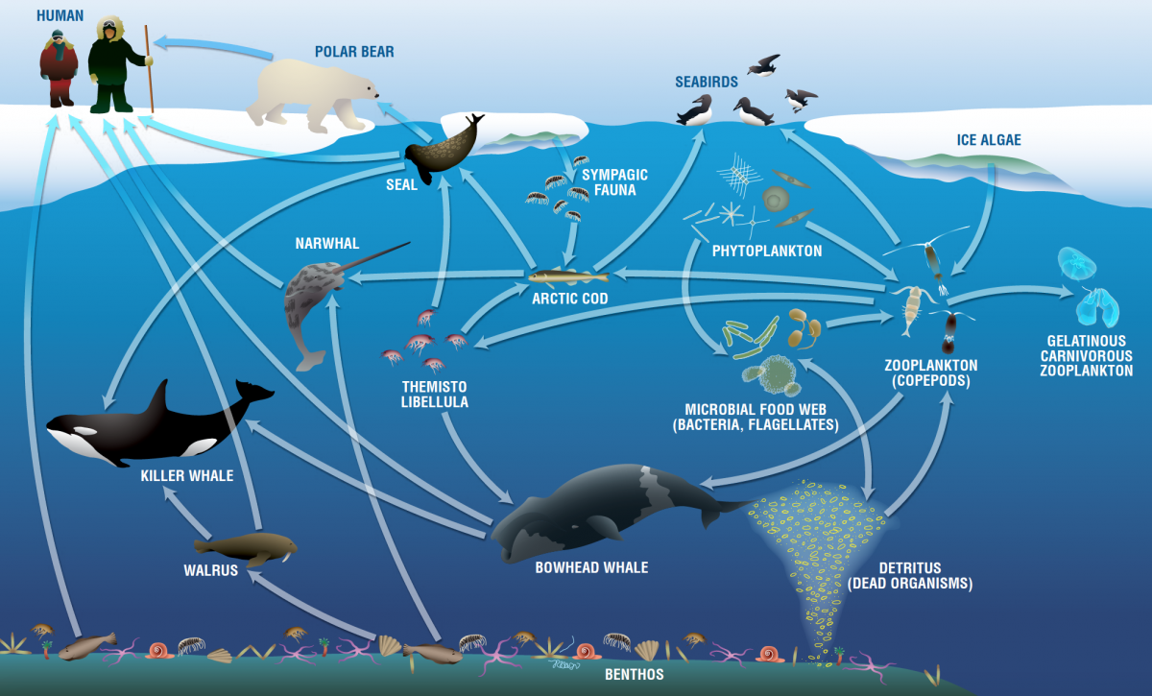
FOOD WEB
Notes:
Explain loss of biodiversity-
Algae and plankton are at the bottom of the food chain (explain what food chain is). Plankton includes many different kinds of tiny animals, plants, or bacteria that just float and drift in the ocean. Other tiny animals such as krill eat the plankton. Fish and even whales and seals feed on the krill. In some parts of the ocean, krill populations have dropped by over 80 percent. Why? Krill like to breed in really cold water near sea ice. What would happen if there were no sea ice? What would happen if there were very little plankton or krill? The whole food web could come unraveled.

Slide 11
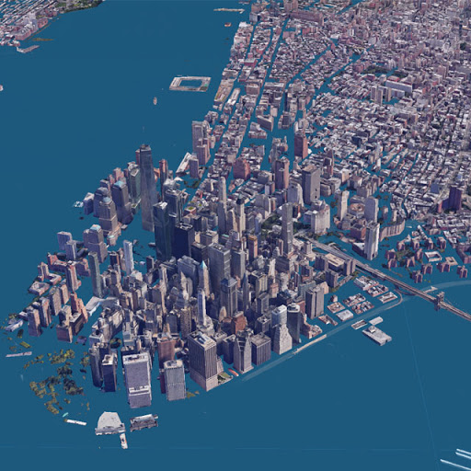
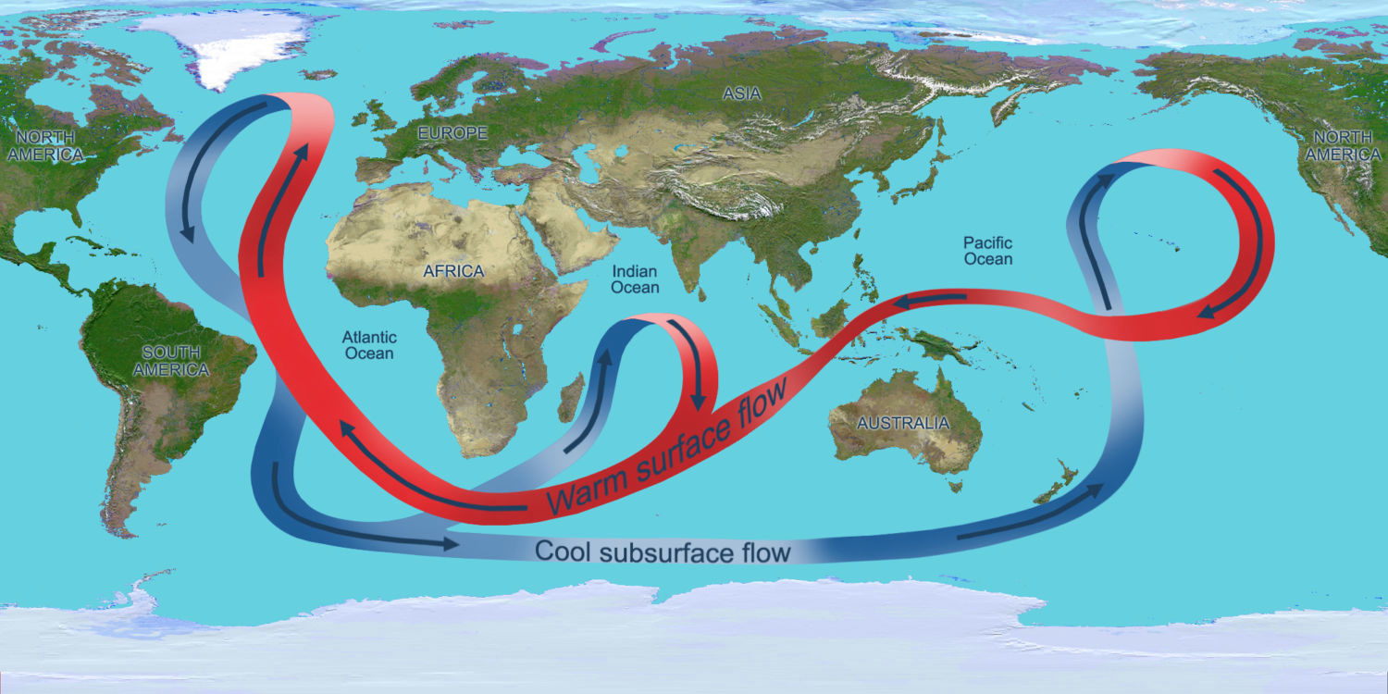
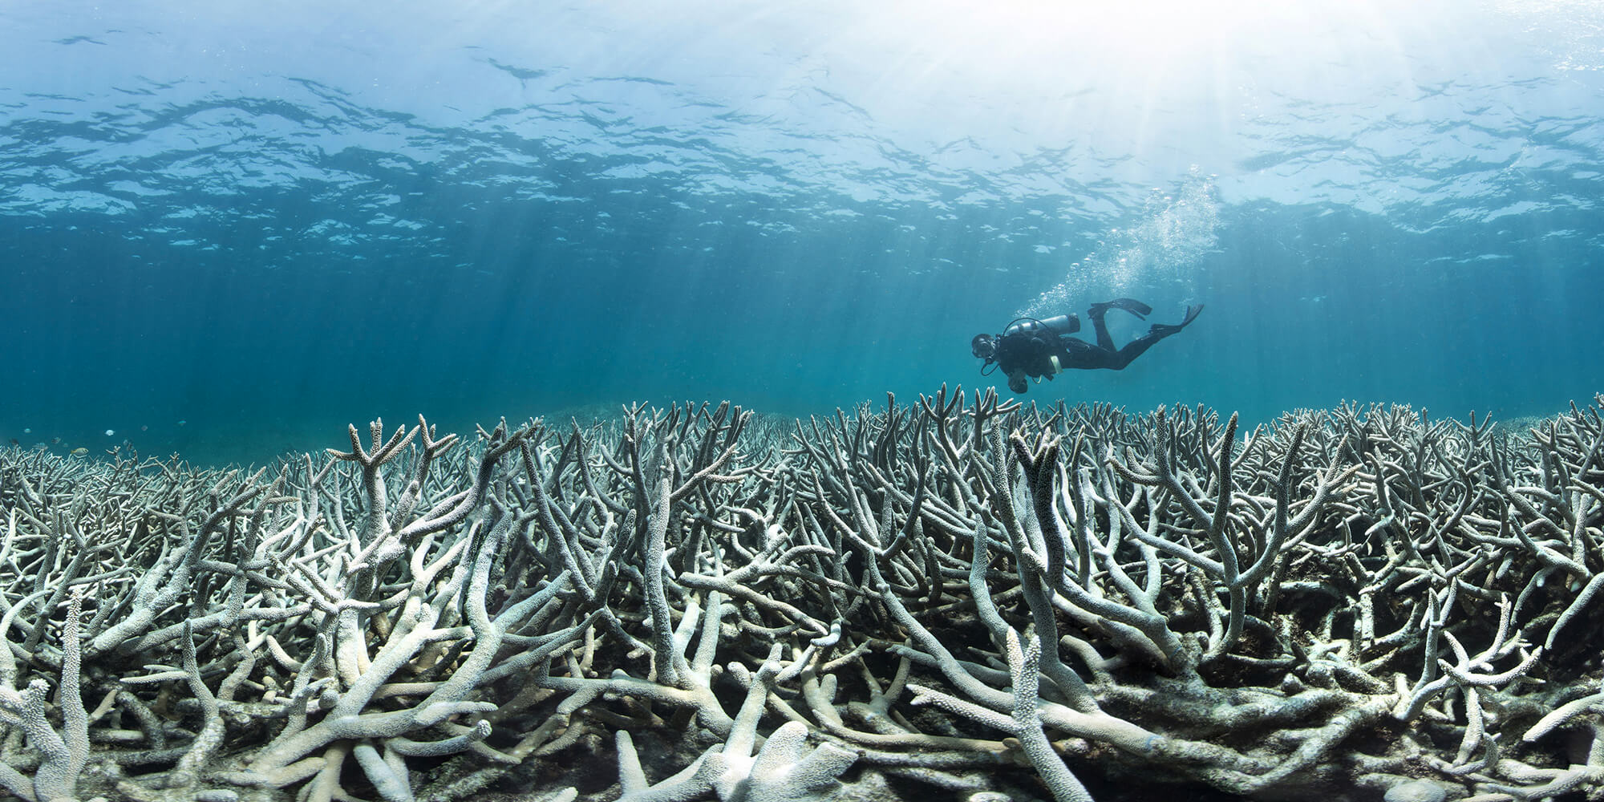
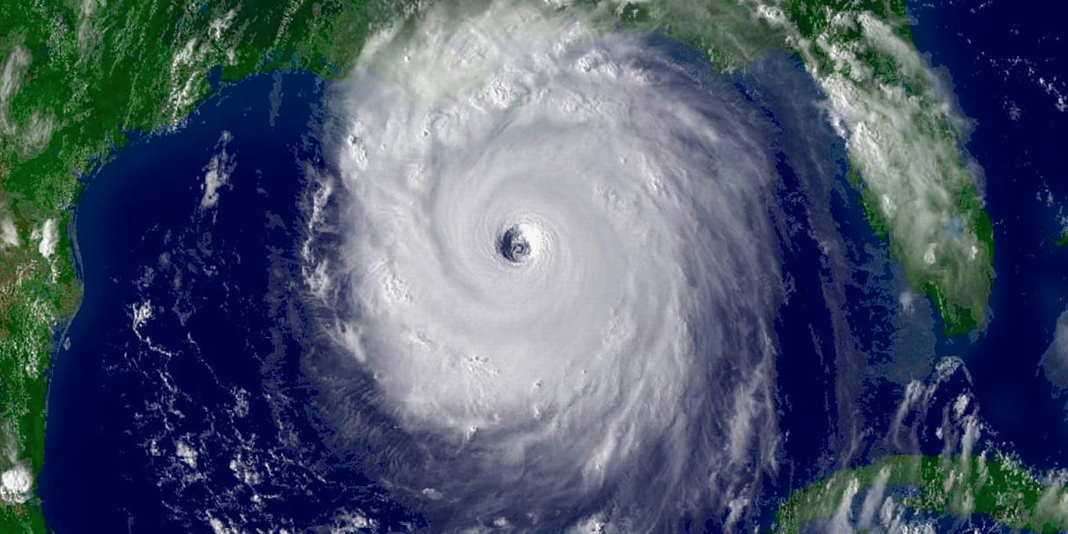
WHAT IS THE ISSUE?
Changes in ocean currents
Sea level rise
Loss of species
More natural disasters
Notes:
At the front line of climate change, the ocean, the coastlines and coastal communities are being disproportionately impacted by increasing CO2 and other greenhouse gas emissions from human activities. The ocean absorbed 93% of the extra energy from the increased greenhouse effect, with warming now being observed at depths of 3,280ft. As a consequence, this has led to increased ocean stratification, changes in ocean currents, sea level rise, ocean acidification and expansion of depleted oxygen zones. At the same time, weather patterns are changing, with extreme events increasing in frequency.
Explain sea level rise-
Water has a high heat capacity, meaning that it takes a lot of energy (heat) to actually warm up the ocean. The ocean does an excellent job of absorbing excess heat from the atmosphere. The top few meters of the ocean stores as much heat as Earth's entire atmosphere. So, as the planet warms, it's the ocean that gets most of the extra energy. This results in sea level rise. If the ocean gets too warm, then the plants and animals that live in it must adapt—or die.

Slide 12
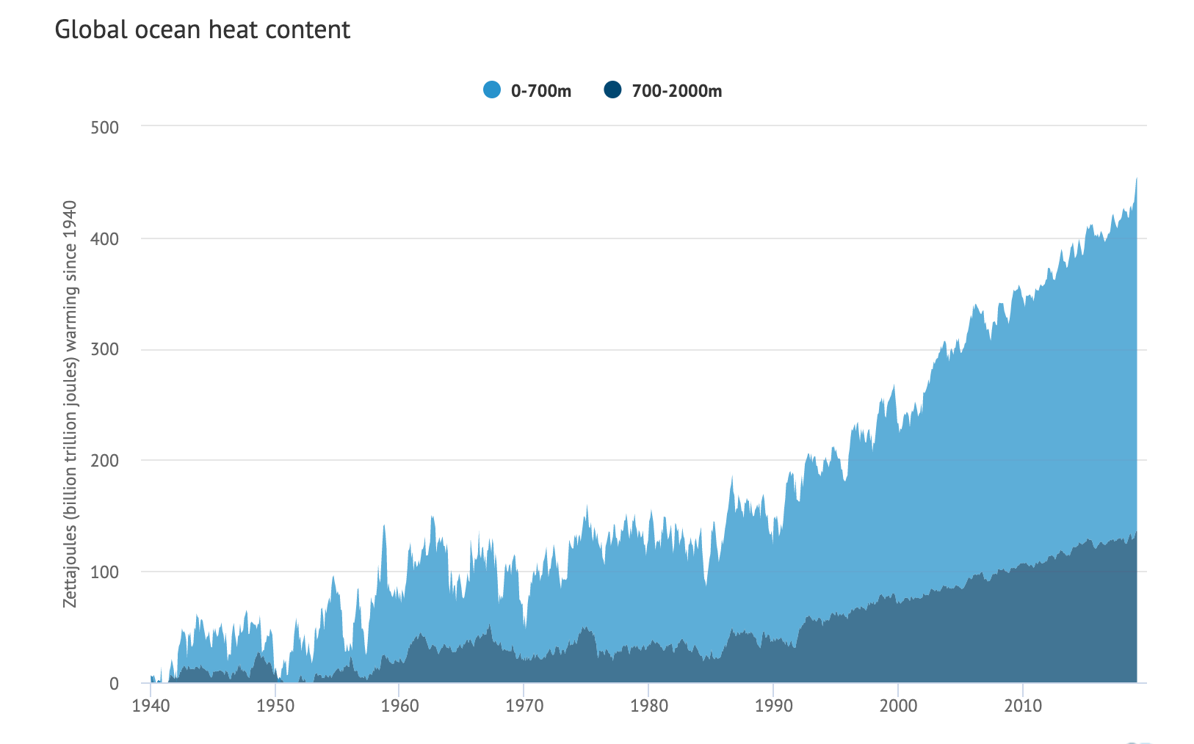
Notes:
here are two main causes of sea level rise and both are due to heat. Glaciers and ice sheets are large masses of ice that sit on the land. As our planet warms, this ice melts and flows into the oceans. More water in the oceans makes sea level higher. Secondly, water expands as it gets warmer. So, warm water takes up more room in our oceans – making sea levels higher. Ocean warming accounts for around half of the observed change in sea level, with the melting of thousands of glaciers accounting for the other half of the increase in sea level. These two things combined have raised sea level about 7 to 8 inches since 1900. That's a big problem for the millions of people who live in communities near the coast. When the sea level rises, people will be affected in different ways, depending on where they live.

Slide 13
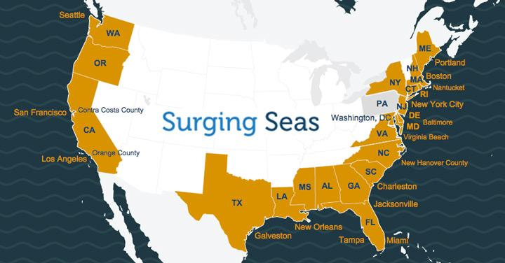
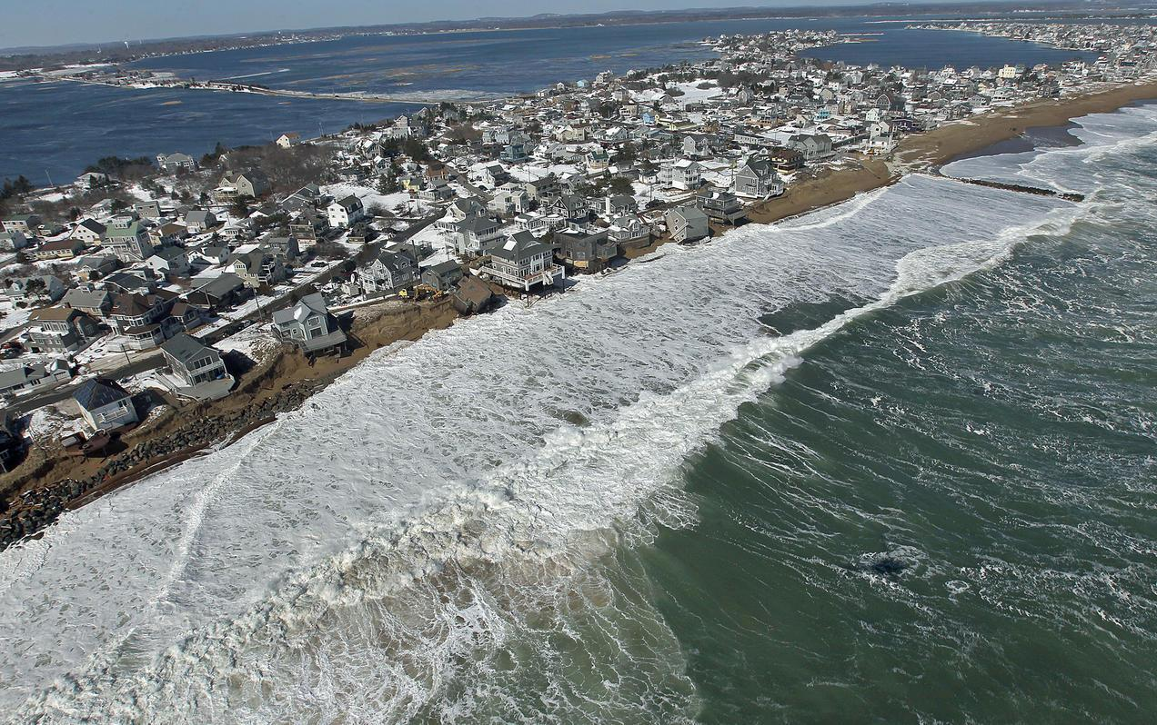

Slide 14
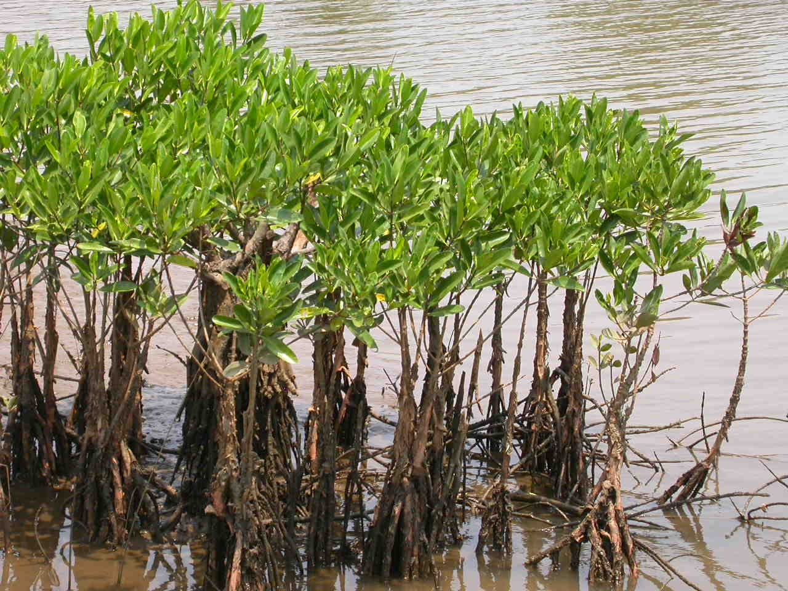
MANGROVES
What are mangroves?
Notes:
Mangroves are important types of trees. They grow where salt water meets fresh water. These forests provide a habitat for many types of species. It acts as a nursery for sharks, fish, crocodiles, turtles, and more. Mangroves protect land from wave impact due to storms as well as coastal erosion. They protect coral reefs from sedimentation. However, sea level rise is flooding mangrove forests. With less space to expand, the mangroves are dying off at alarming rates. Additionally, daming and clearing land for agriculture is weakening mangroves.

Slide 15
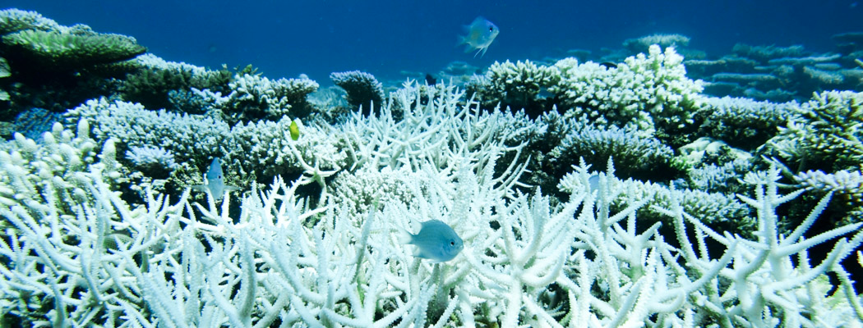
CORAL BLEACHING + INTERACTIVE ACTIVITY
NASA KIDS FOR CLIMATE

Slide 16
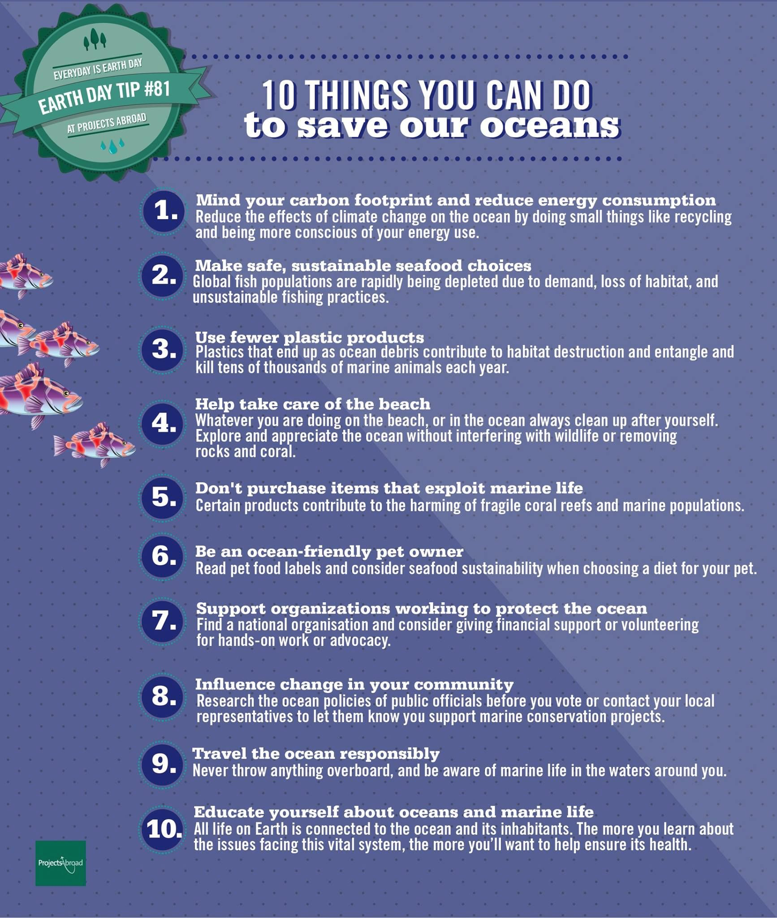
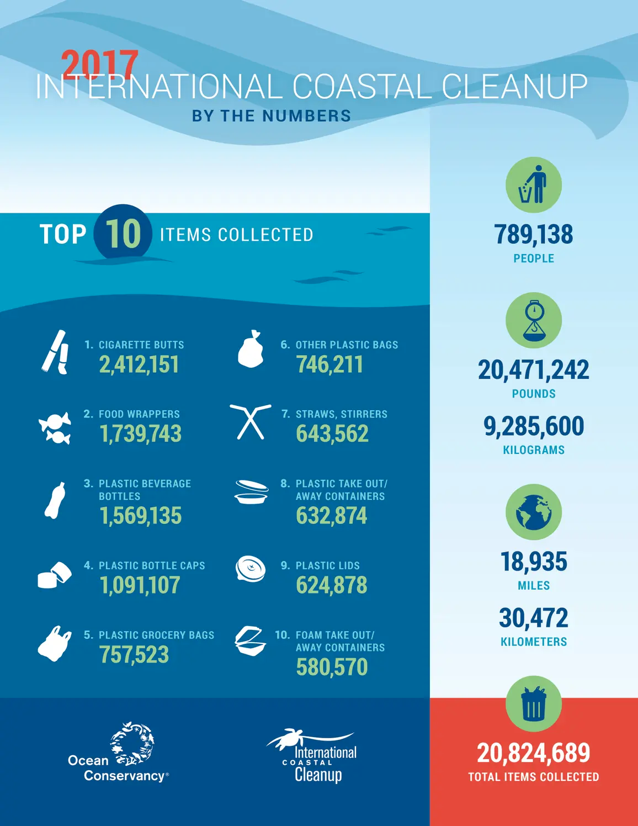

Slide 17
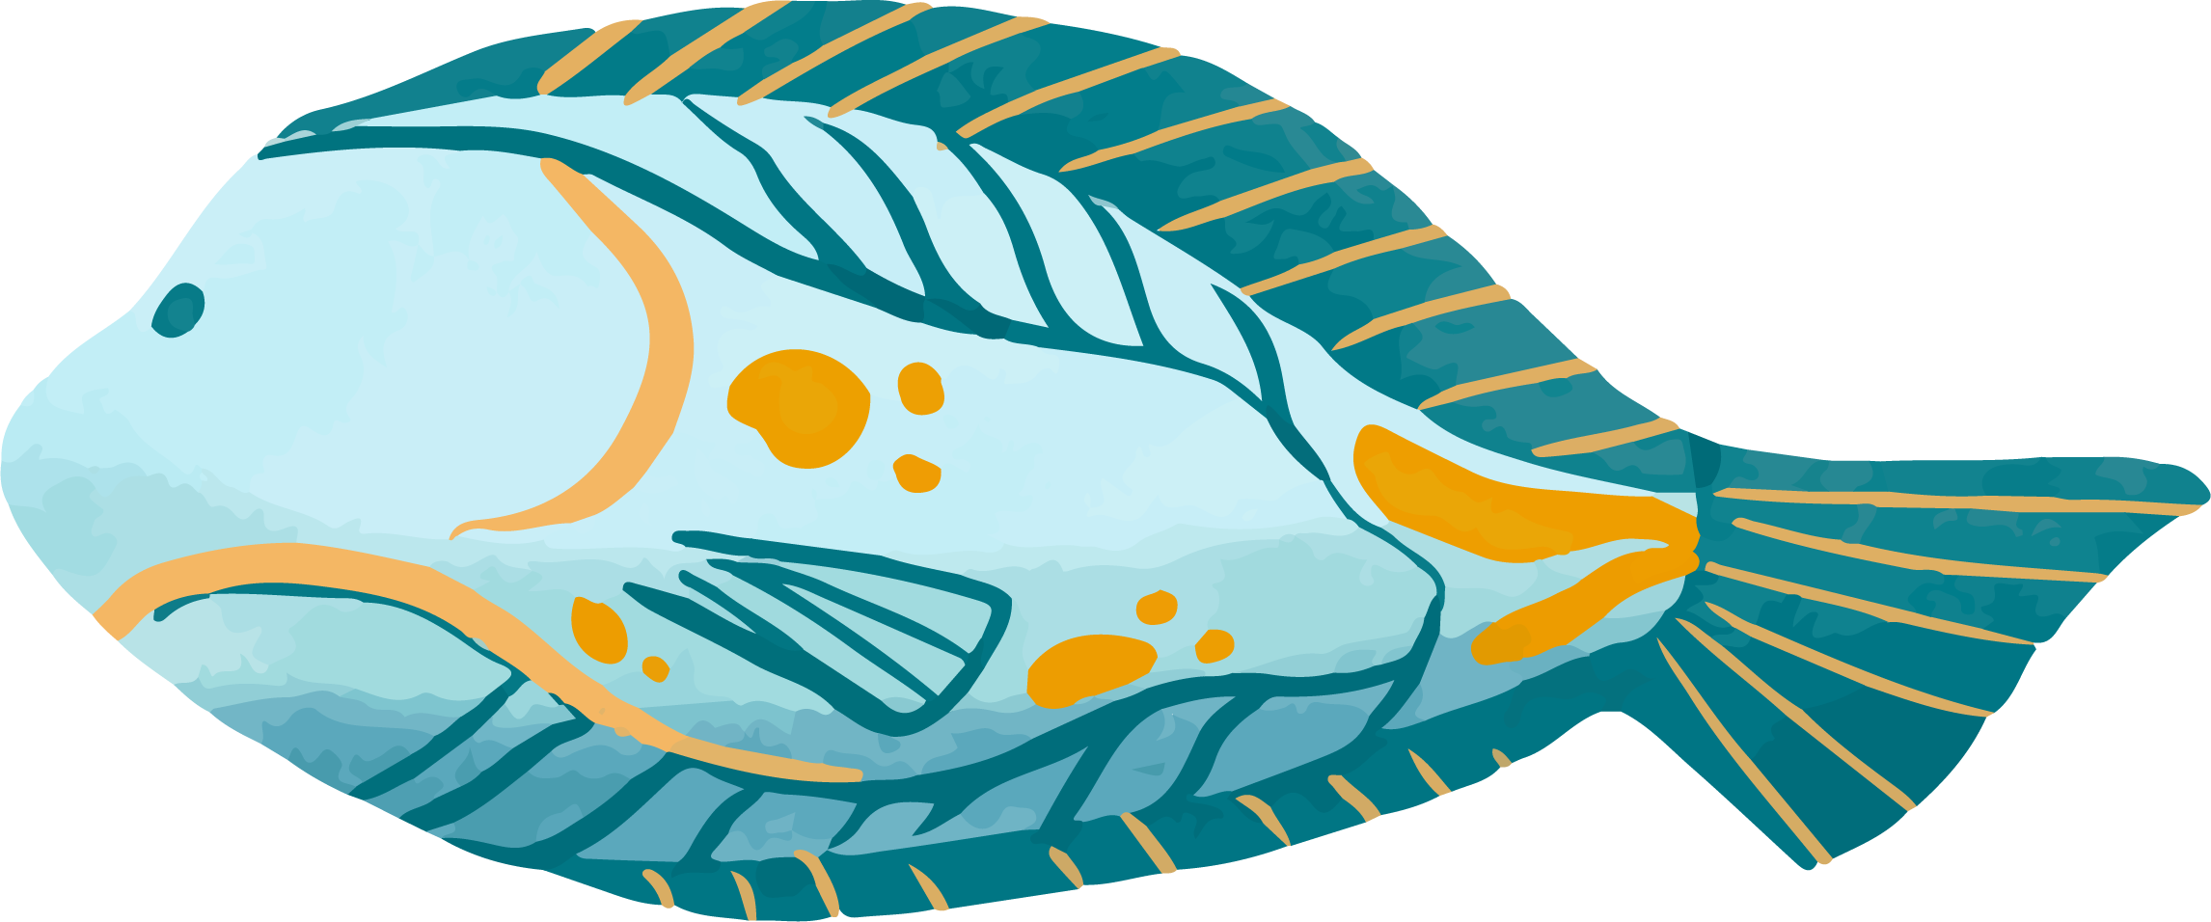
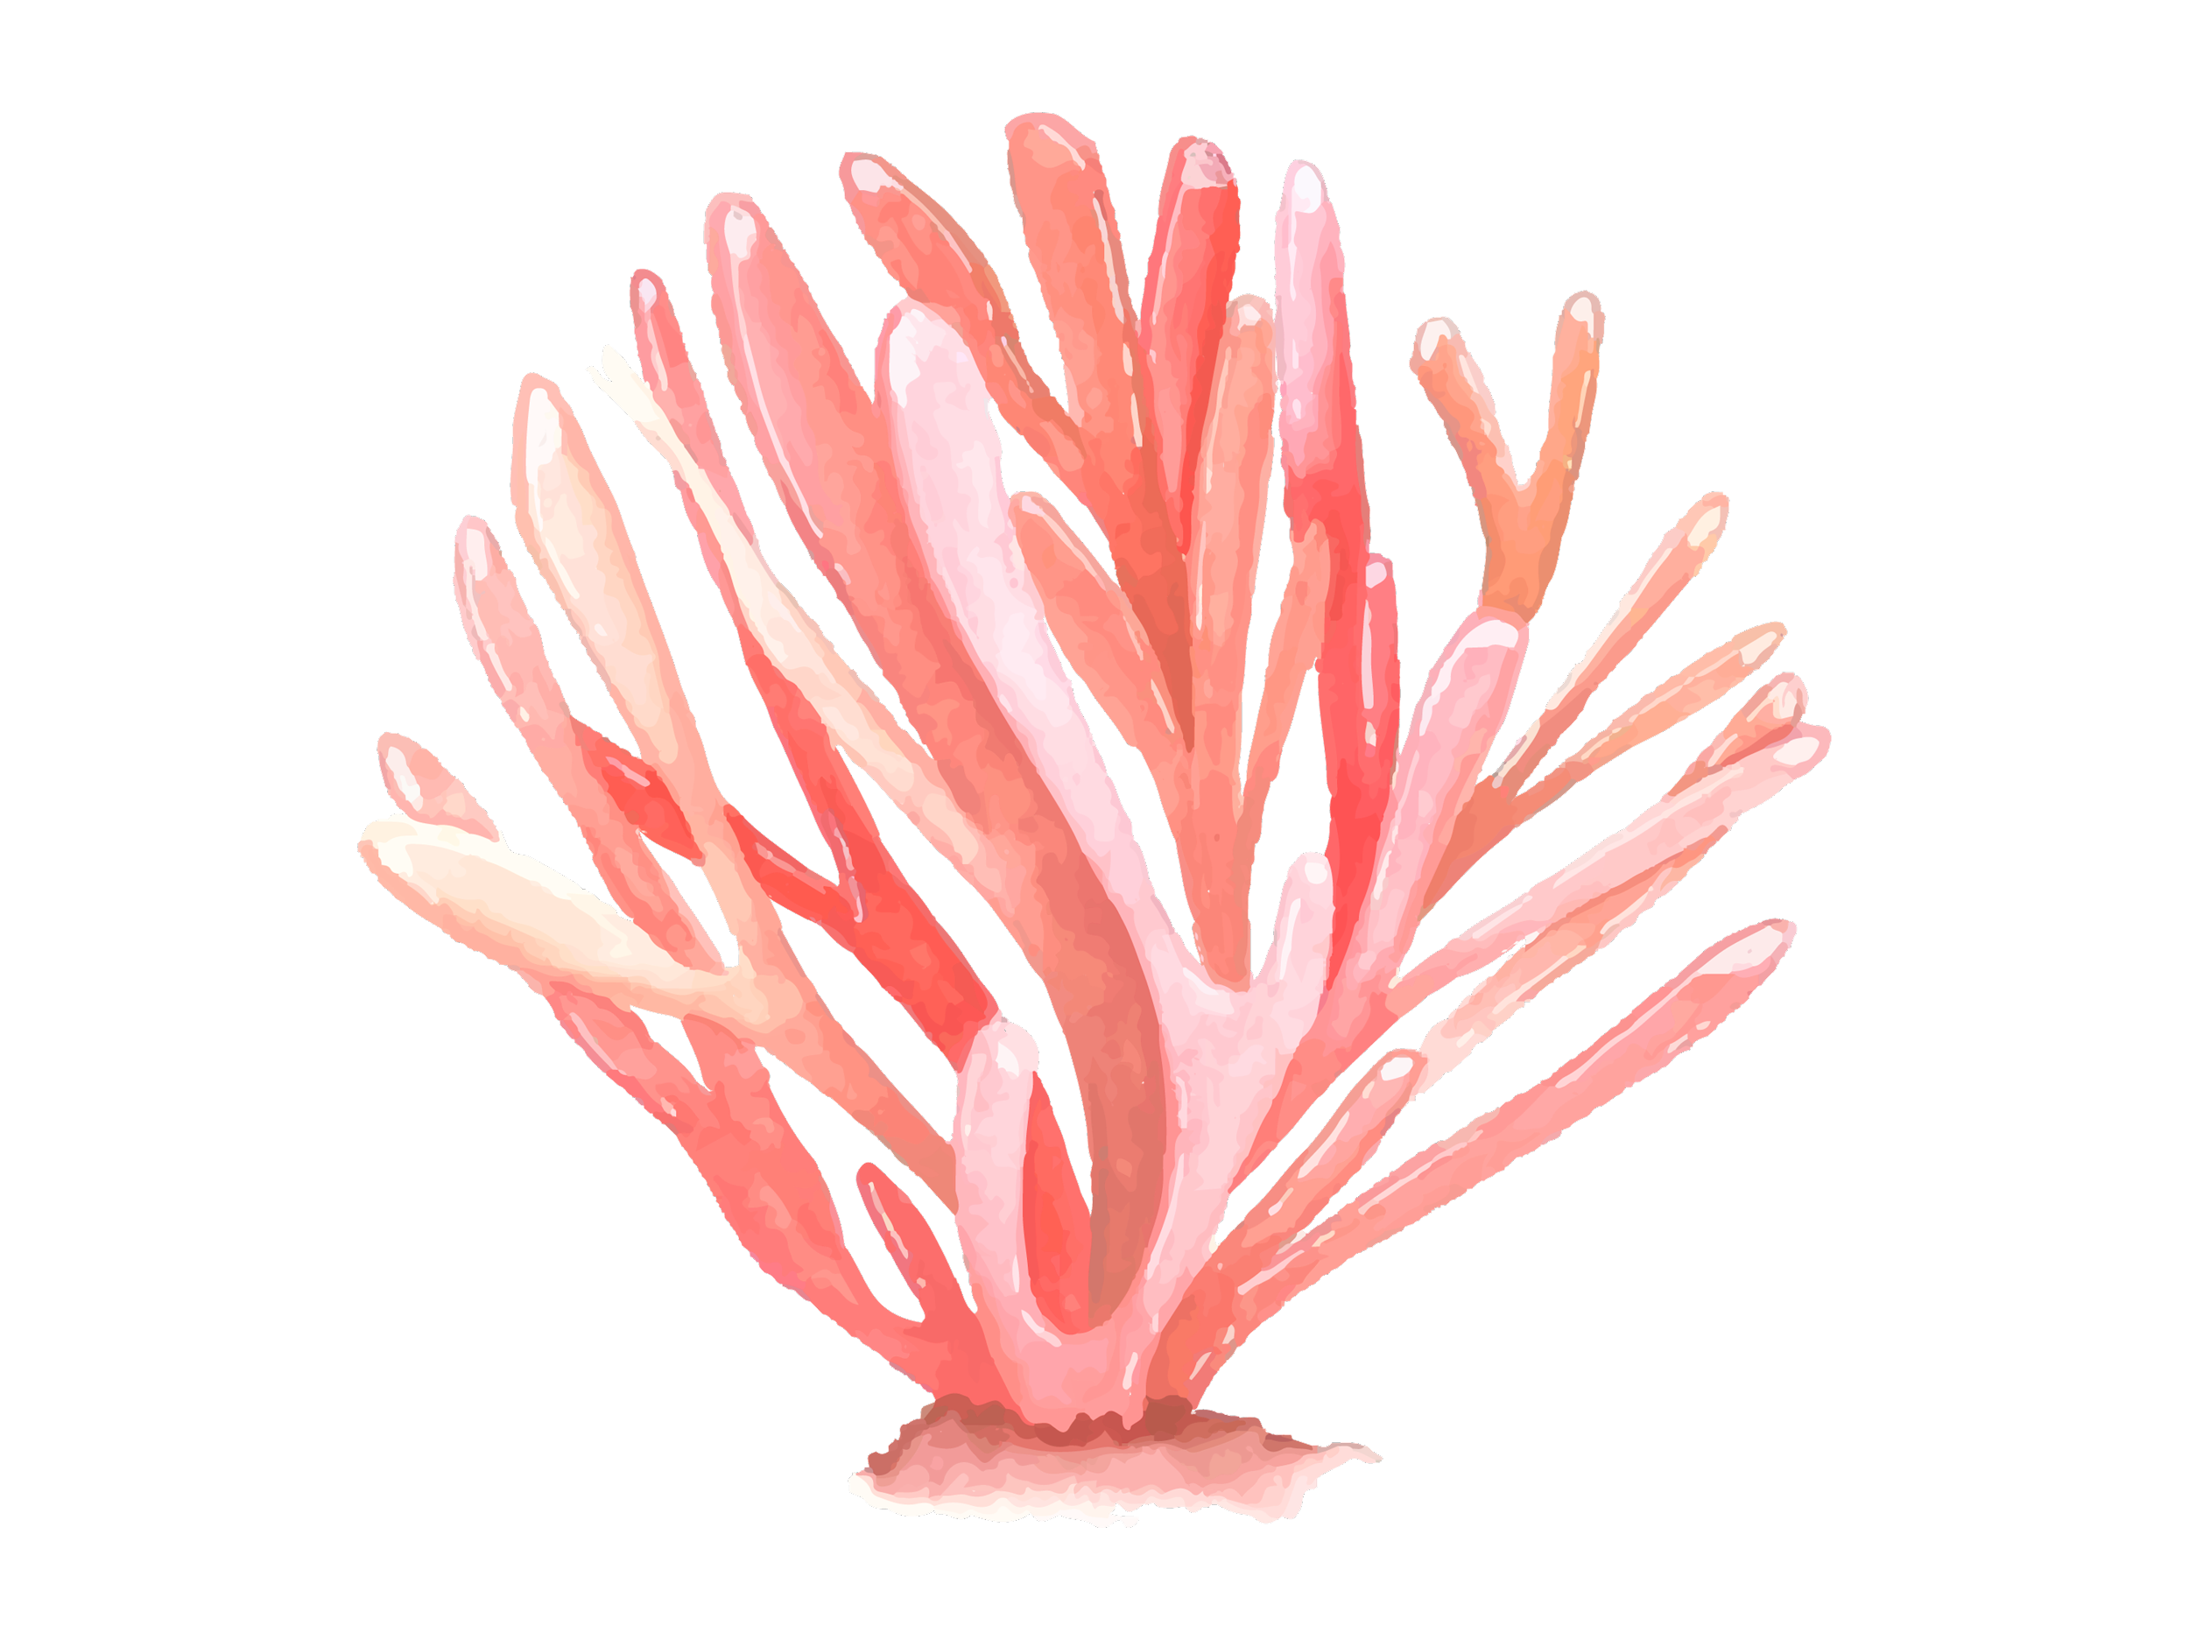
REVIEW
What did you learn?
Questions

Slide 18
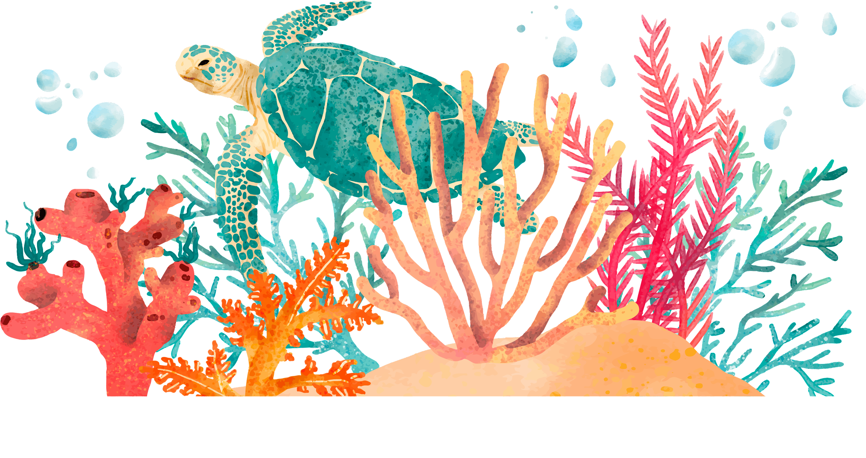
Optional Assignment
Perform a waste audit (write down what you’re throwing away throughout the day). As you keep track of your waste, think about what you’re frequently disposing of and how you can limit your waste

Slide 19
THANKS!
If you have any questions please email thegreencauseinitiative@gmail.com

